Slide 1

Criando Microservices com Java EE 7
George Gastaldi
Principal Software Engineer – Red Hat

Slide 2

Agenda
Java EE e Microservices
WildFly Swarm: Conceito
Demo
Q&A

Slide 3
Microservices
Desacoplados
Ciclos de liberação independentes
Micro funcionalidade != linhas de código
Preferencialmente auto-contido
Escalar independentemente

Slide 4
Como SOA, mas diferente ...
Linux Containers
Infraestrutura elástica e automatizada (nuvem)
Larga adoção de CI (Integração Contínua)
Larga adoção de princípios e práticas DevOps

Slide 5
Martin Fowler
In short, the microservice architectural style is an approach to developing a single application as a suite of small services, each running in its own process and communicating with lightweight mechanisms, often an HTTP resource API. These services are built around business capabilities and independently deployable by fully automated deployment machinery. There is a bare minimum of centralized management of these services, which may be written in different programming languages and use different data storage technologies.

Slide 6
Martin Fowler
In short, the microservice architectural style is an approach to developing a single application as a suite of small services, each running in its own process and communicating with lightweight mechanisms, often an HTTP resource API. These services are built around business capabilities and independently deployable by fully automated deployment machinery. There is a bare minimum of centralized management of these services, which may be written in different programming languages and use different data storage technologies.

Slide 7
Microservices & Java EE
Nem todo mundo quer usar Docker
Nem todo mundo quer usar Node.js
Muitos estão felizes com Java EE
  Componentes robustos e maduros
  Escalável, baseado em padrões e bem integrado
Nem todo mundo quer usar tudo o que Java EE provê
  Subsistemas de um servidor de aplicação

Slide 8
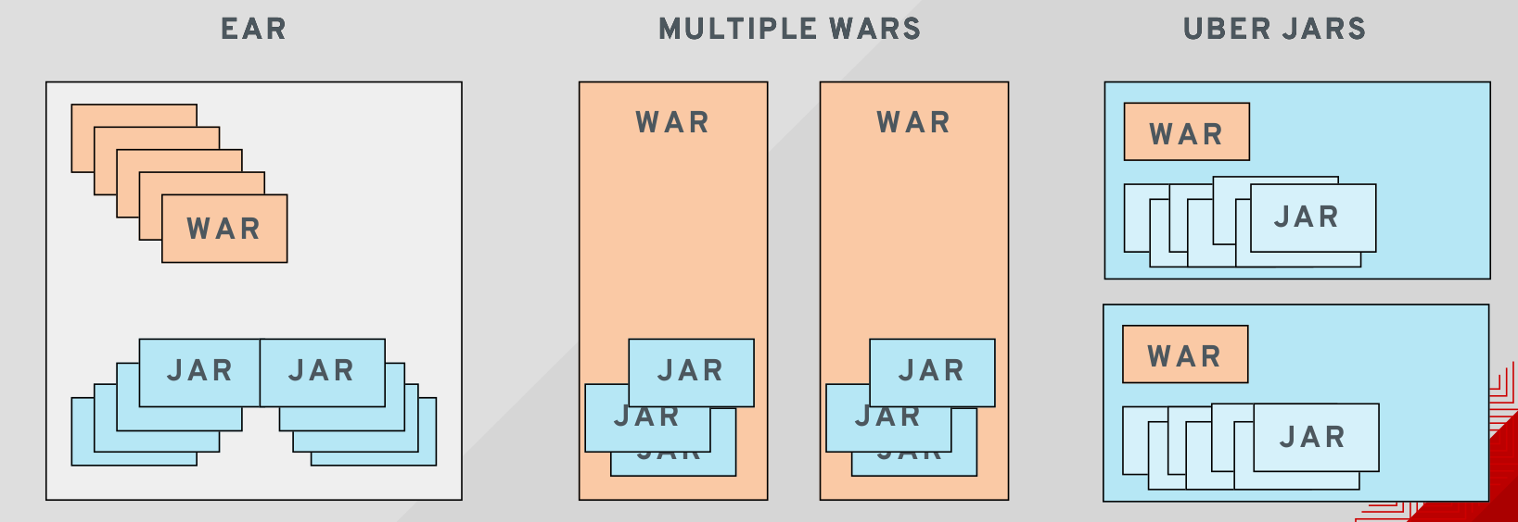

Slide 9
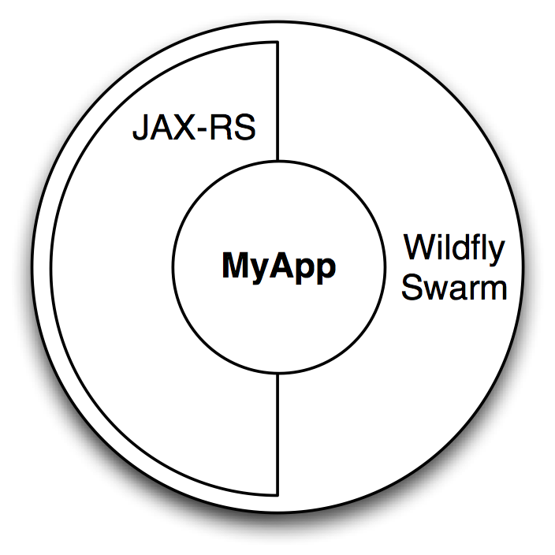
UberJar
Um simples JAR contendo a sua aplicação

Slide 10
Java EE Monolítica
DB
Servidor de Aplicação
WAR
Pedidos EJB
EJB
Pedidos JAX-RS Endpoint
Invoice JAX-RS Endpoint
UI

Slide 11
Java EE Microservices
DB
JAR
JAR
Pedidos EJB
Invoice EJB
Pedidos JAX-RS Endpoint
Invoice JAX-RS Endpoint
JAR
UI

Slide 12
Hello World JAX-RS
WildFly Swarm

Slide 13
WildFly Swarm
Permite que você possa escolher os serviços Java EE necessários para a sua aplicação
WildFly em partes – Fractions
  UberJars – JARs auto-contidos
Não é limitado aos subsistemas WildFly
  NetFlix OSS – Ribbon, Hystrix

Slide 14
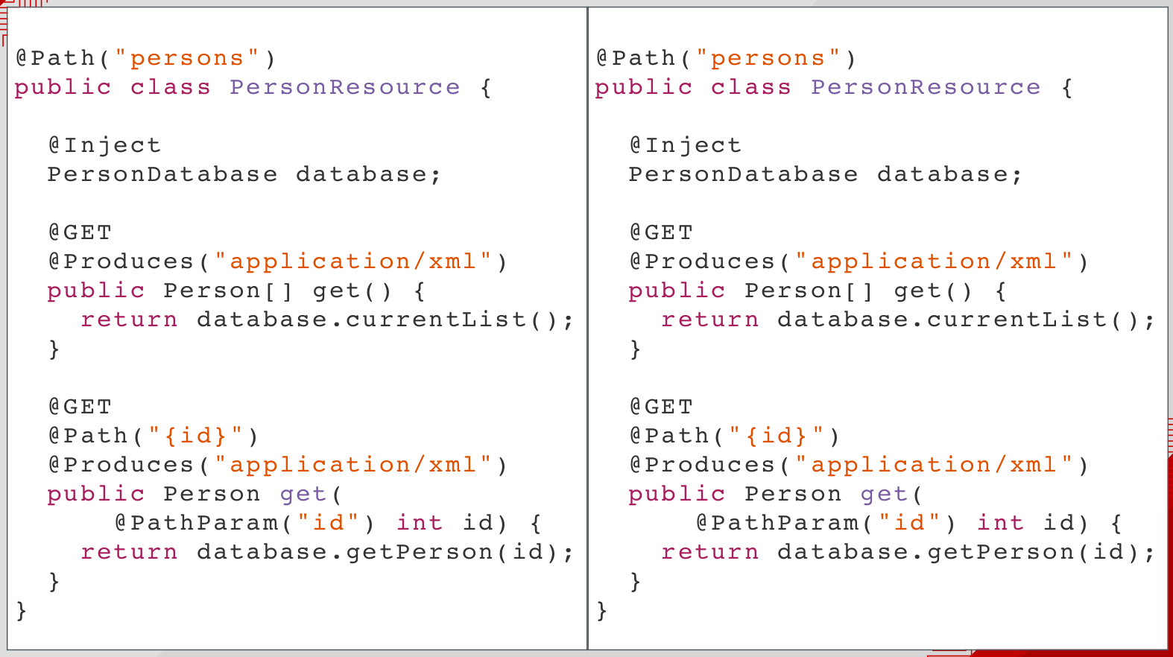

Slide 15
Fractions

Slide 16
Fractions
Basicamente
  Define um module.xml para um JAR(s) com qualquer dependência
  Usado quando:
    Existem Subsistemas não inclusos no WildFly : RxJava, RxNetty
    Necessitar ativar módulos WildFly excluídos por padrão
Fractions existentes cobrem 99% dos casos
Podem substituir as dependencias Maven existentes

Slide 17
Fractions
Herança
  Dependência entre frações no Maven (JAX-RS → Undertow)
Agregação
  Uma Fraction pode ser definida com dependências em qualquer combinação de Fractions (ex: jpa-mysql → jpa + mysql)

Slide 18
Fractions
WildFly Subsystems
DataSource | EJB | JAX-RS | JCA | Transactions
Remoting | JPA | KeyCloak | JSF | Messaging
Undertow | CDI | BeanVal | JMX | Mail
Clustering | Infinispan | Hawkular | Validator | Batch
JGroups | Webservice | Logging | Hibernate Search
Non-WildFly
Ribbon | Hystrix | LogStash | Camel
RxJava | RxNetty | Hashicorp Consul | Swagger

Slide 19
DEMO TIME !

Slide 20
Layout 1
JAX-RS Endpoints
JPA
AngularJS UI

Slide 21
Layout 2
AngularJS UI
JAX-RS Endpoints
JPA

Slide 22
Layout 3
AngularJS UI
JAX-RS Endpoints
JPA
KeyCloak

